Slide 1
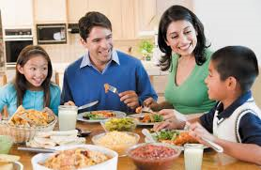
Healthy Eating for Families
January 21st, 2015
Jennifer Glen, MS, RD

Slide 2
General healthful eating
Switch to skim or 1% milk
Make half your plate fruits and veggies
Make half your grains whole
Notes:
Aim for a balanced diet that reduces excess fat and sugar. Encourage water or low-fat milk as beverages

Slide 3

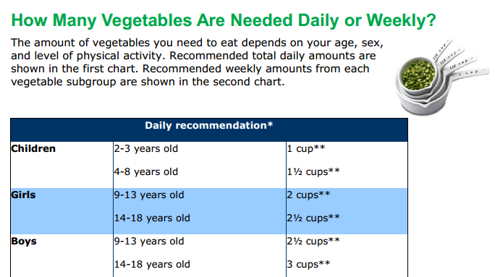
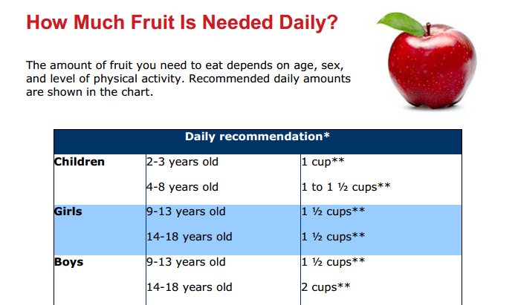
Sneak in More Fruits and vegetables
http://www.choosemyplate.gov/printpages/MyPlateFoodGroups/Vegetables/food-groups.vegetables-amount.pdf

Slide 4
Sneak in More Fruits and vegetables
Fritattas
  Try something new! Make a fritatta with plenty of vegetables added
Muffins
  Bake your favorite muffins with carrots, zucchini, pumpkin, or applesauce mixed in
Sauce
  Spice up regular tomato sauce with different pureed veggies
Smoothies
  Blend low-fat yogurt or milk with frozen fruit for a quick serving of dairy and fruit!
http://www.letsmove.gov/healthy-families
Don’t give up on introducing new types of food!
Kids may need to be exposed to a new fruit or vegetable up to 30 times before they will try it and include it in a regular diet.

Slide 5
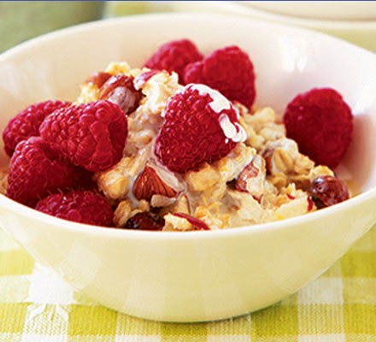
Kids who eat Breakfast…
Miss less school
Do better in math
Therefore more likely to graduate HS
Cereal/milk
Oatmeal/fruit
Hard boiled egg
Eng muffin/PB
Apple or banana/PB

Slide 6
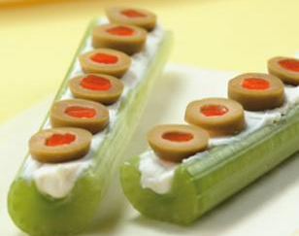
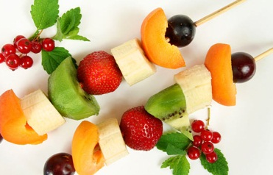

Healthy Snacks
Homemade trail mix
  Mix unsalted nuts, seeds, and dried fruit. Pre-portion for the week!
Vegetables and healthy dip
  Serve raw or cooked veggies with plain yogurt mixed with herb seasoning mix
Frog, ants, bugs on a log
  For a salty/crunchy snack use cream cheese and olives on celery
Fruit kabobs
  Melon, grapes, kiwi with vanilla yogurt for dipping
Rice cakes topped with cream cheese or peanut butter or nutella!
Discourage snacking in front of the TV or while using other electronics
Allowing your child to focus on their snack will reduce overeating

Slide 7
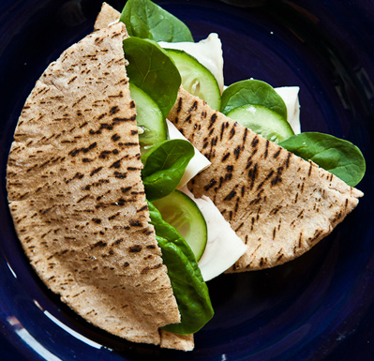
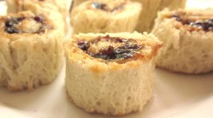
Healthy Lunches
Traditional Lunch with a twist
Turkey and cheese pita pockets
  Add veggies and hummus for extra nutrients
Pizza roll-up
  Whole wheat wrap, part-skim mozzarella, sauce and pepperoni
Peanut butter and jelly sushi
  Traditional PB&J in a fun shape

Slide 8
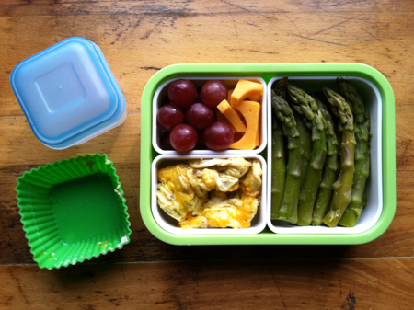
Healthy Lunches
The Bento box idea
Fresh fruit with yogurt or cheese
Cut-up cooked or raw veggies
Chicken, tuna, egg salad

Slide 9
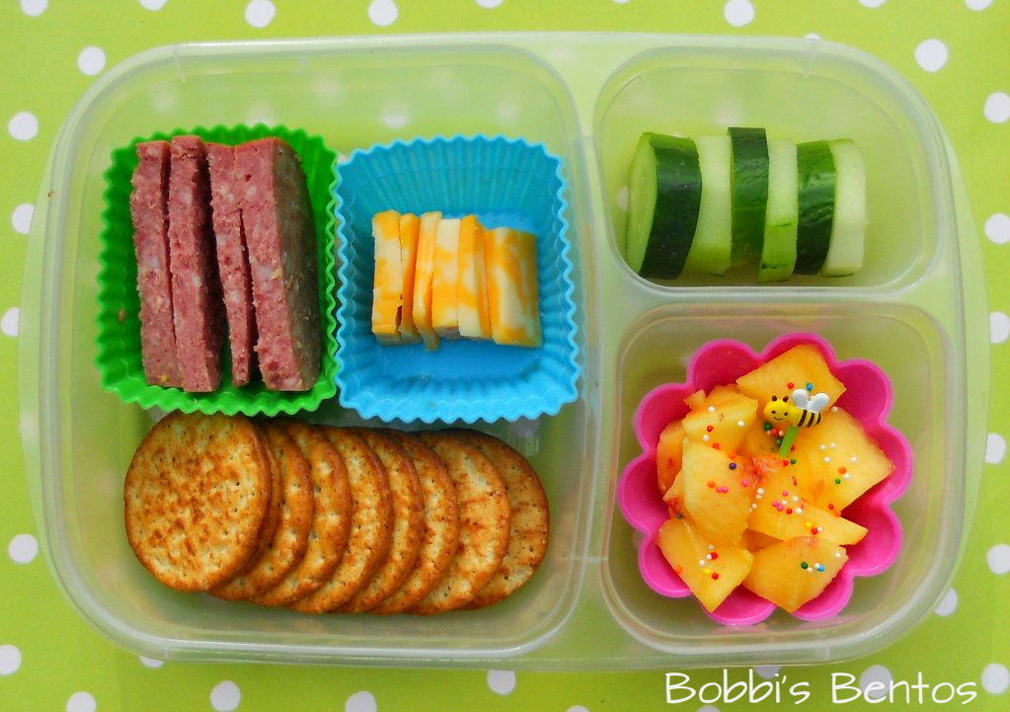
Healthy Lunches
The Bento box idea
Carrot or cucumber sticks with dip
Sliced meat & cheese
Fruit salad or applesauce
Whole grain crackers or sweet potato chips

Slide 10
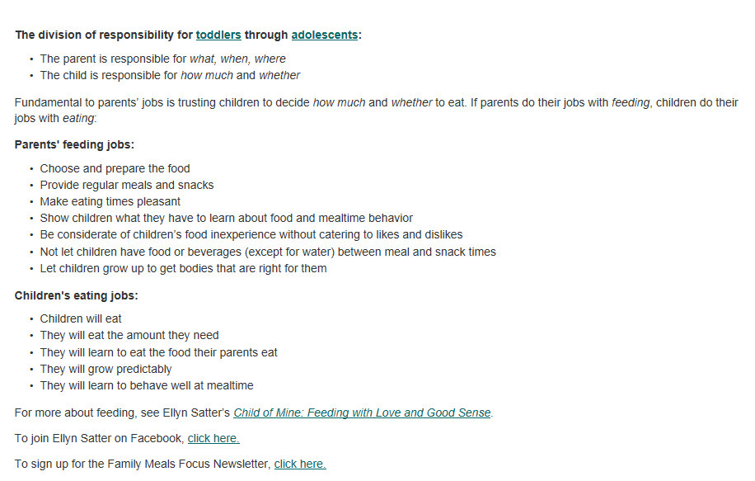
Division of Responsibility

Slide 11
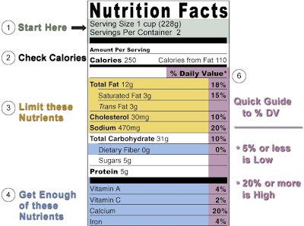
Check out the Nutrition facts label
http://www.fda.gov/Food/IngredientsPackagingLabeling/LabelingNutrition/ucm274593.htm#see4

Slide 12
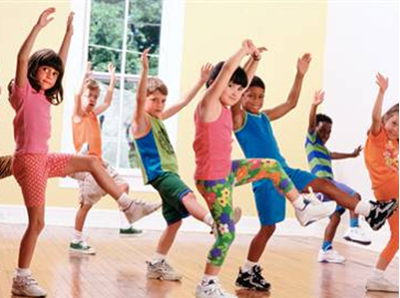
Be an active family
Keep an activity calendar
  Plan ahead what fun events you will do that month and stick with it!
Housework and chores count as activity!
Limit TV time
  Or make a rule- every 30 min TV is allowed per 30 min. activity.
Take a walk together after dinner
Adults need 30 min. of activity 5x/week.
And children need 60 min activity 7x/week!

Slide 13
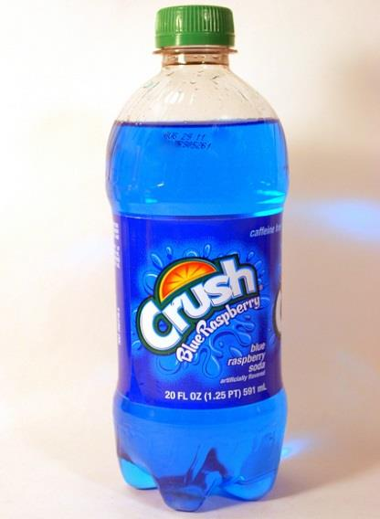
A better beverage
Encourage water or low-fat milk for hydration
  2-3 cup milk/day (kids ages 4-18 years old)
Limit sugar sweetened beverages (juice, soda, sweet ice tea, lemonade)
How many teaspoons of sugar do you think are in 12 oz of juice or soda?

Slide 14
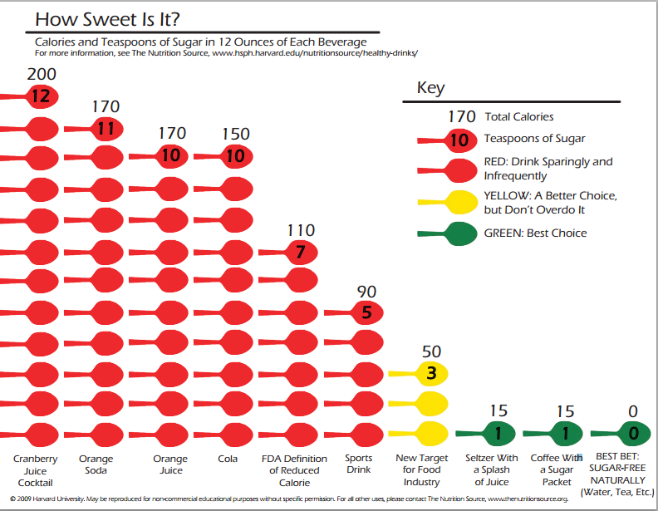
A better beverage
How Sweet is It? From Harvard School of Public Health
http://www.hsph.harvard.edu/nutritionsource/how-sweet-is-it/

Slide 15
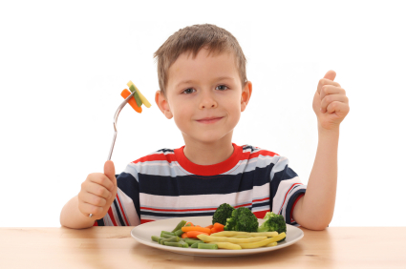
Find more facts and recipes…
http://www.choosemyplate.gov/
http://www.letsmove.gov/healthy-families
http://www.eatright.org/kids/
http://www.nutrition.gov/life-stages/children

